Slide 1
Pokemon Image Classification
By: Aaron Dzaboff and Jacob Swinton

Slide 2
Background Information
Problem Definition

Slide 3
Introduction
Pokemon was first released in 1996
Since then over 100 games have been released
Third best selling game Franchise of all time
Spawned numerous TV shows

Slide 4
Mechanics
Main gameplay is battling other trainers
Each Pokemon has as at least one type
Certain types have advantages compared to others
Type Advantage core to the game

Slide 5
Our Dataset
Only looking at Grass and Water Pokemon
These stark differences should make classification relatively simple
Model struggles with Pokemon who break these norms
Generalities about Water and Grass Pokemon
Type | Water | Grass
Color | Blue | Green
Resemblance | Aquatic creatures | Flora

Slide 6
Methodology

Slide 7
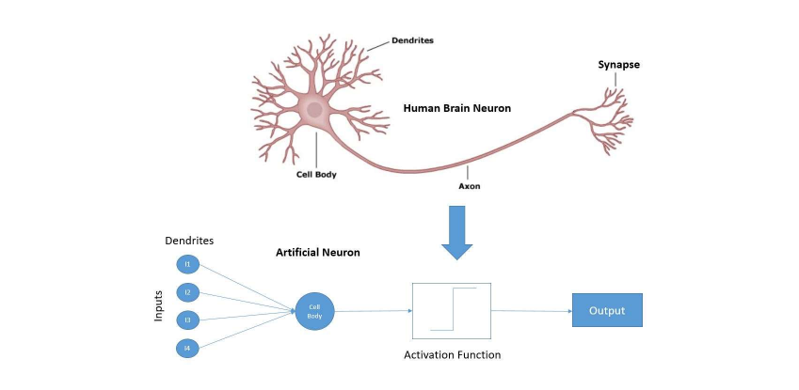
How Neural Network Works:

Slide 8
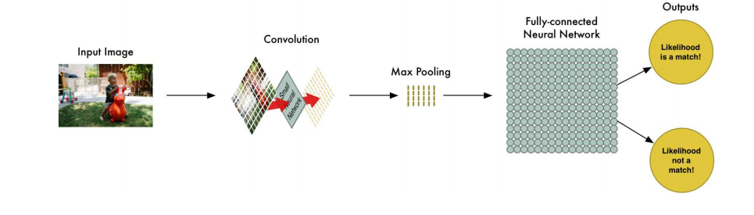
How a CNN works:

Slide 9
Methodology
Only classifying Grass and Water Pokemon
93 grass Pokemon and 126 water Pokemon
Created three models
Pre-trained, with data augmentation and without
Data augmentation created 5 new validation and 3 three new training pictures for both

Slide 10
Results
How did the networks fare?
What Pokemon were troublesome?

Slide 11
Test Scores
Model: | Test Score:
CNN w/o Augmentation | 61.36%
CNN w Augmentation | 88.63%
Pre-trained | 77.27%

Slide 12
Best Network
CNN with Augmentation performed the best
Pre-trained performed better than CNN w/o augmentation
VGG16 pre-trained model is best served on everyday objects
The images of Pokemon aren’t generic/everyday objects

Slide 13
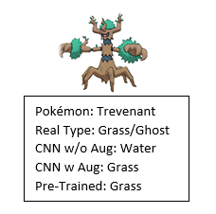
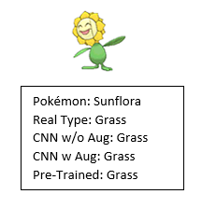
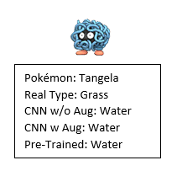
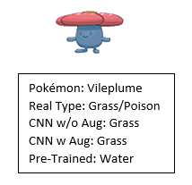
Result Examples - Grass

Slide 14
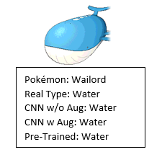
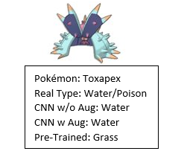
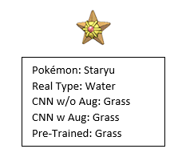
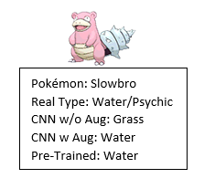
Result Examples - Water

Slide 15
Conclusion

Slide 16
Takeaways
CNN with Augmentation performed the best
Only misclassified 5 Pokemon
3 grass and 2 water types
Networks trained to tell difference in color primarily
Other factors: size, shape, and appearance
Good classification model - 88.63% accuracy

Slide 17
Thank you!
Questions?

